Slide 1
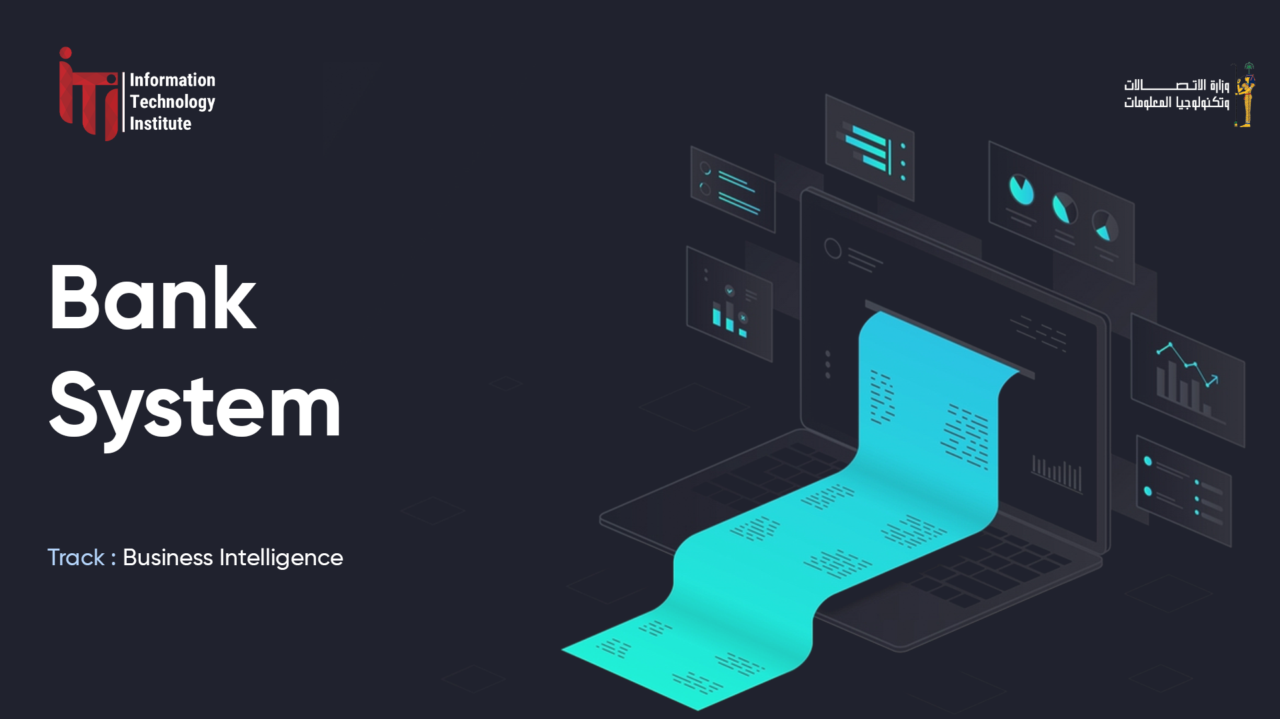

Slide 2

t

Slide 3
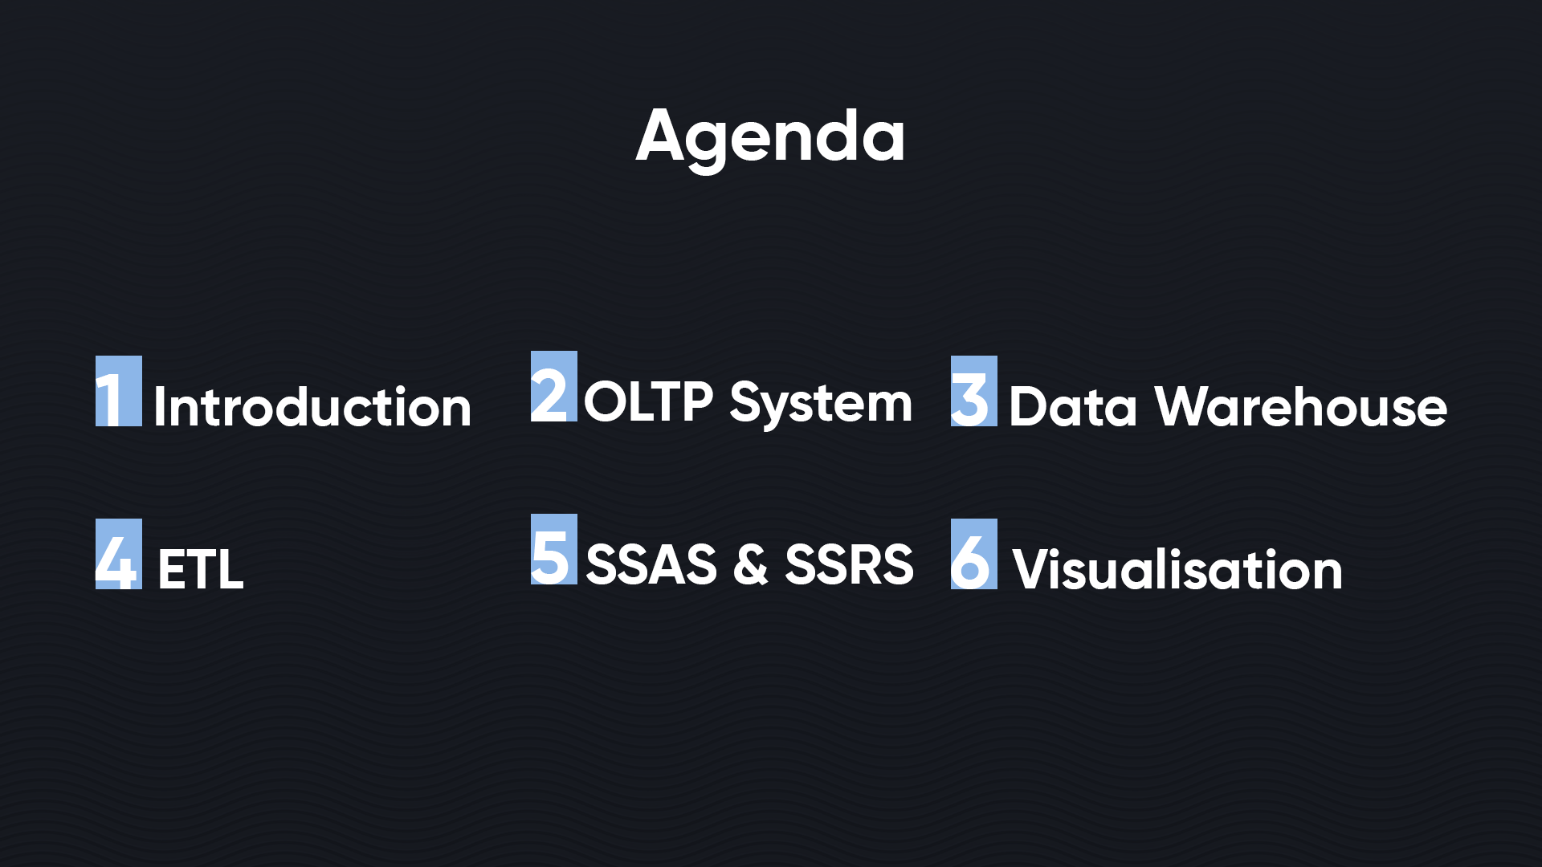

Slide 4

Introduction
The Banking System Project by the Information Technology Institute (ITI) aims to transform banking with a data-driven infrastructure, managing 20,000 customers, 846,000 transactions, and 1,569 ATMs. Focused on developing a comprehensive database and a strategic transaction data mart, the project will enable personalized customer relationship management and improve operational efficiency. By leveraging detailed data analytics, it seeks to anticipate customer needs and enhance risk management. This initiative represents ITI's commitment to innovating banking into a predictive, personalized experience, emphasizing technological advancement and customer service excellence.

Slide 5
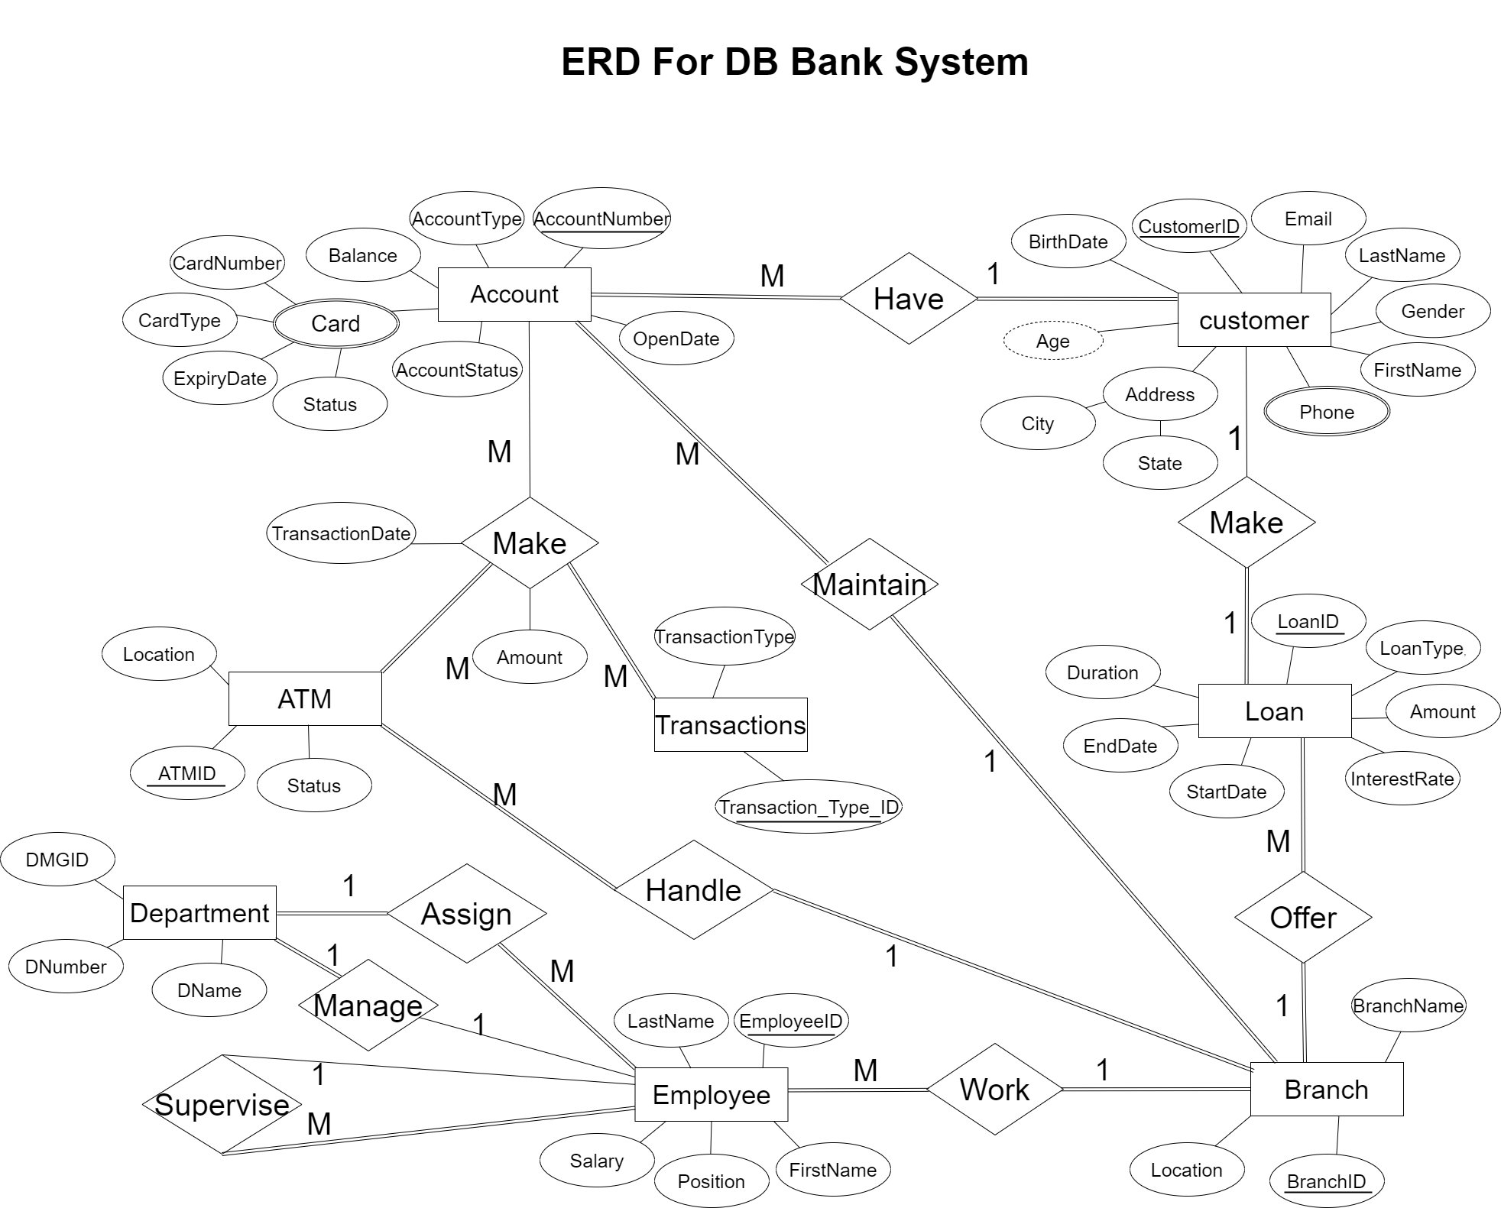
ERD Diagram
Defined Data Relationships between Entity.

Slide 6
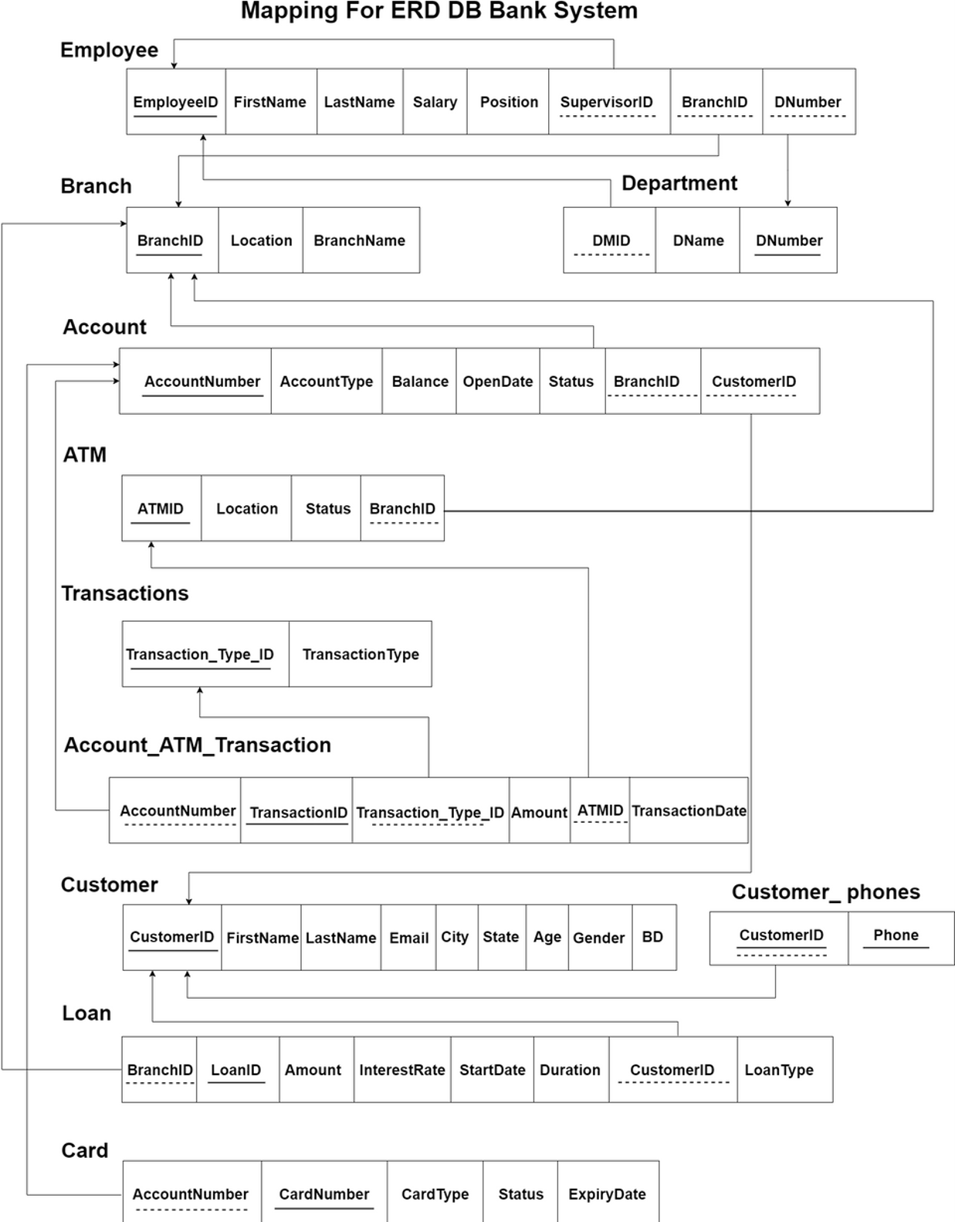
Mapping Schema
Ensures Data flow.

Slide 7
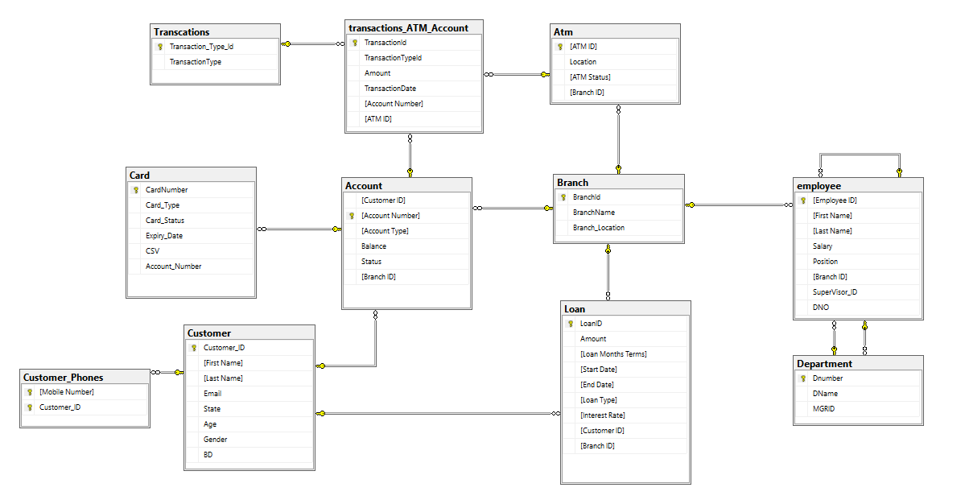
Database Schema
Database system designed to handle and manage real-time transactional workloads.

Slide 8
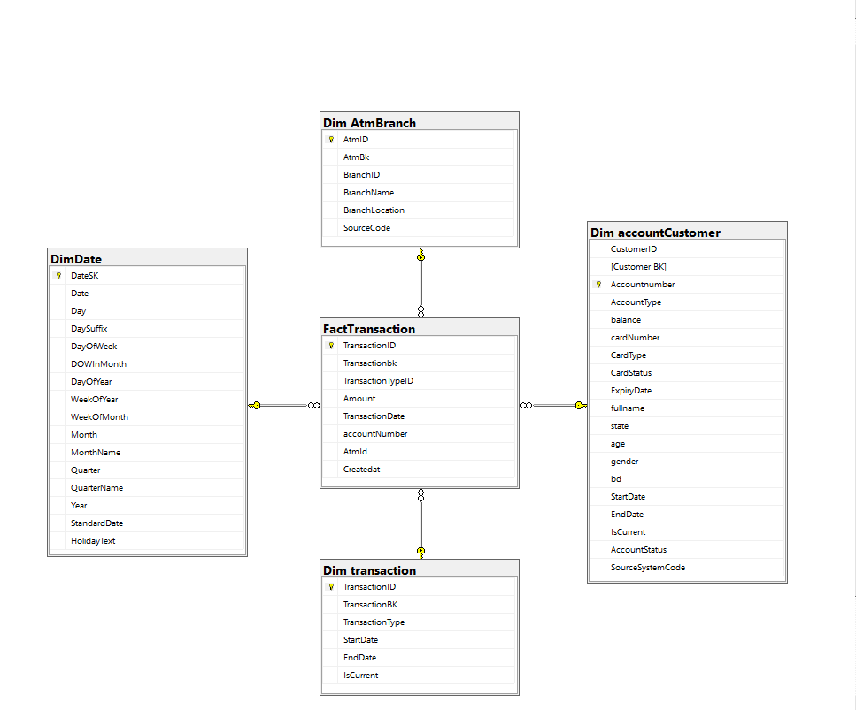
OLAP Schema DWH
Data warehousing centralizes data.
(Star Schema)

Slide 9
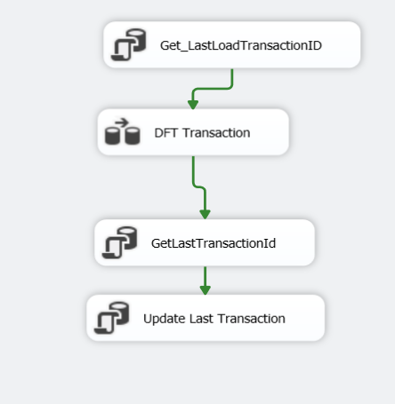
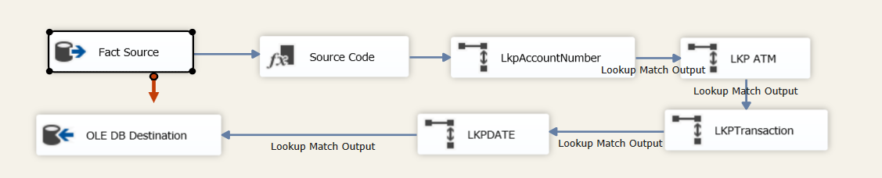
ETL
SSIS Manage Extract, Transform, and Load data from different resources.
Fact Transaction.

Slide 10
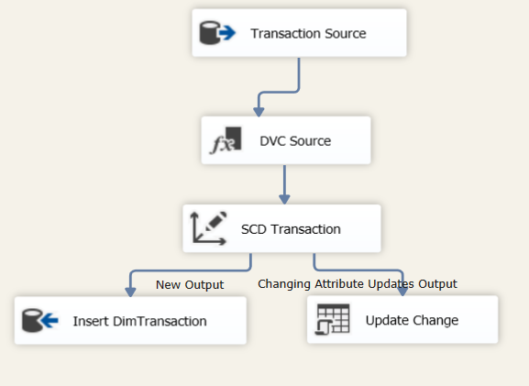
Transaction Dim

Slide 11
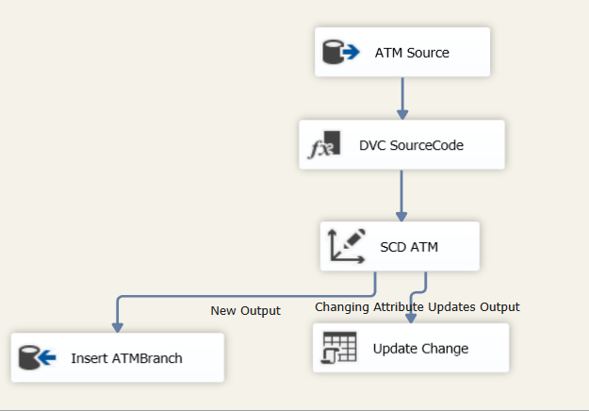
ATM Branch Dim

Slide 12
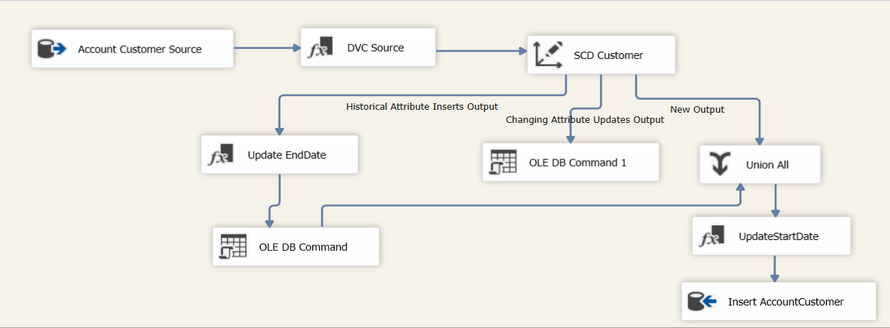
Account Customer Dim

Slide 13
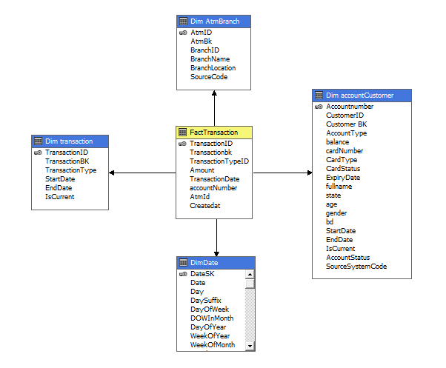
SSAS
Enable Multidimensional analysis with Cubes.

Slide 14
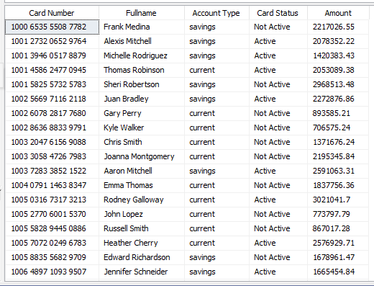
SSAS
Enable Multidimensional analysis with Cubes.

Slide 15
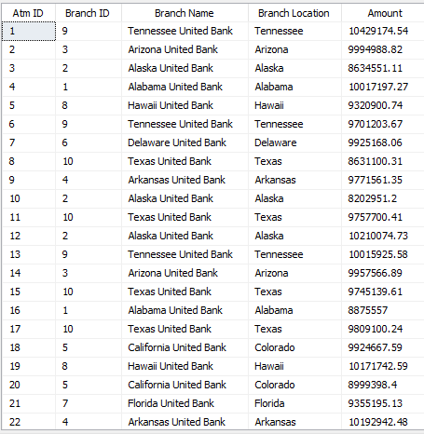
SSAS
Enable Multidimensional analysis with Cubes.

Slide 16
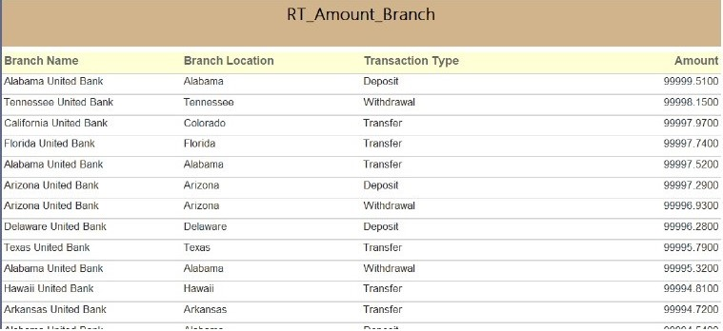
SSRS
SSRS produces reports .

Slide 17
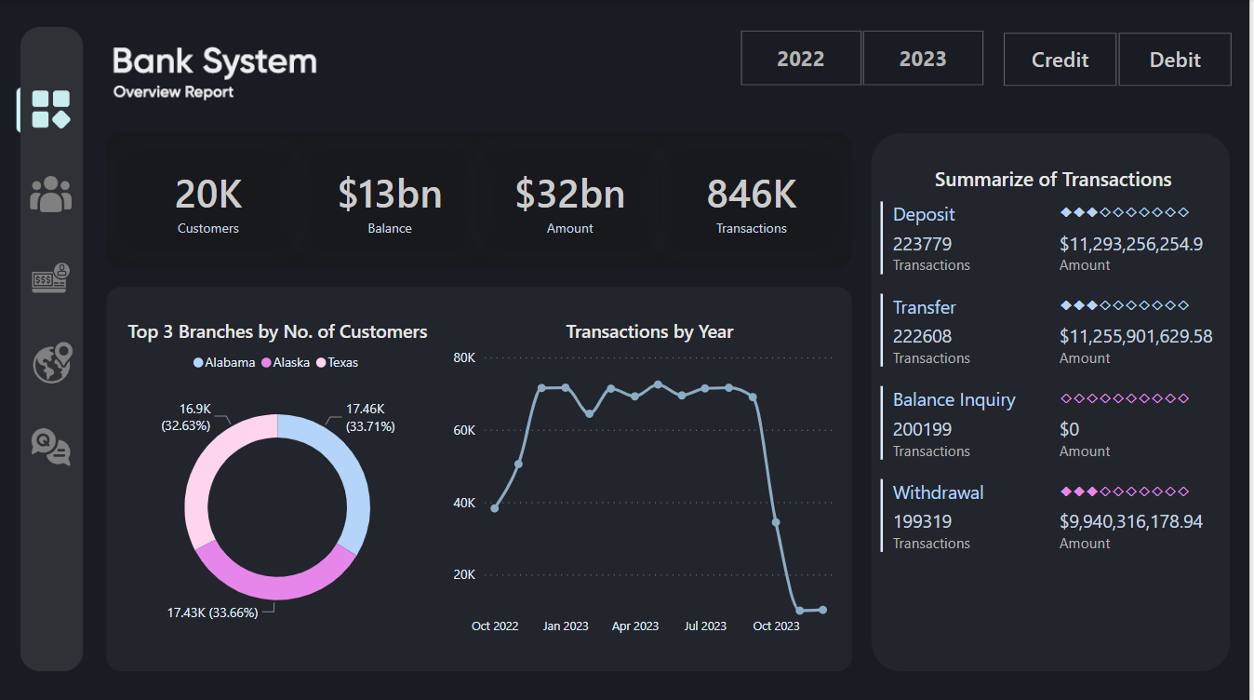
Visualize Power Bi. Overview Report

Slide 18
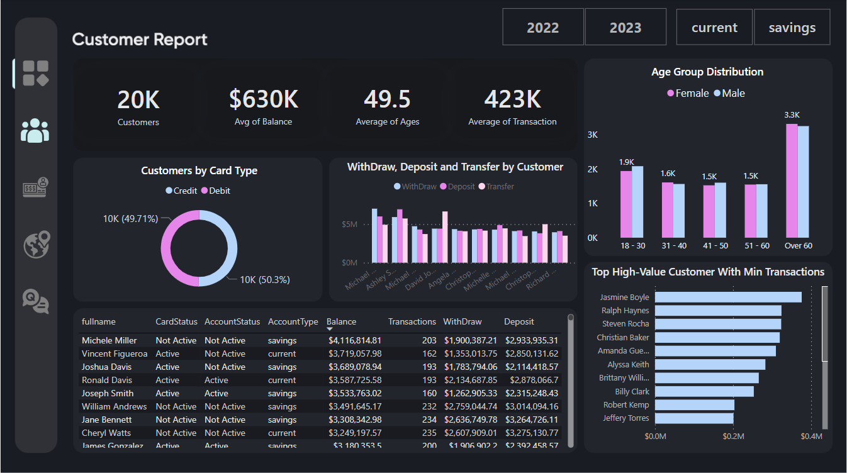
Customer Report

Slide 19
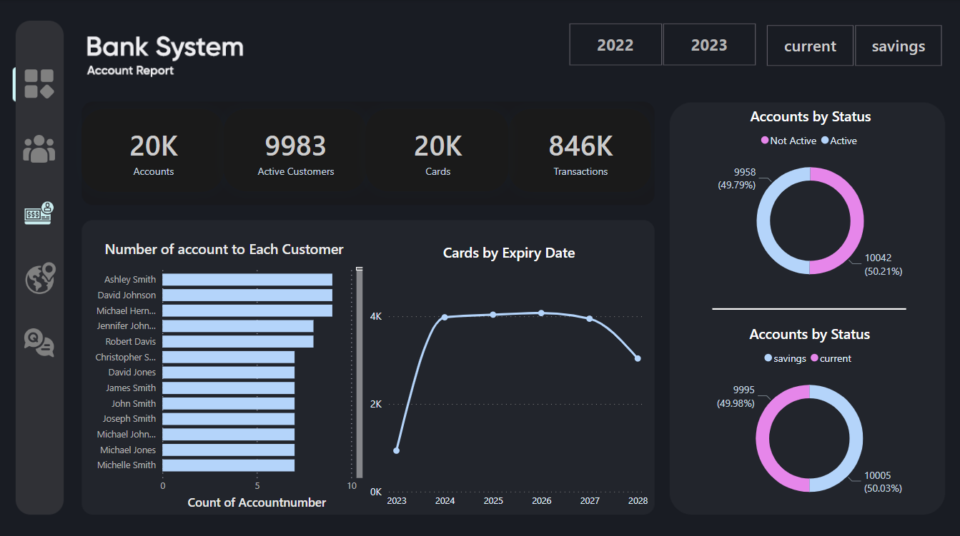
Account Report

Slide 20
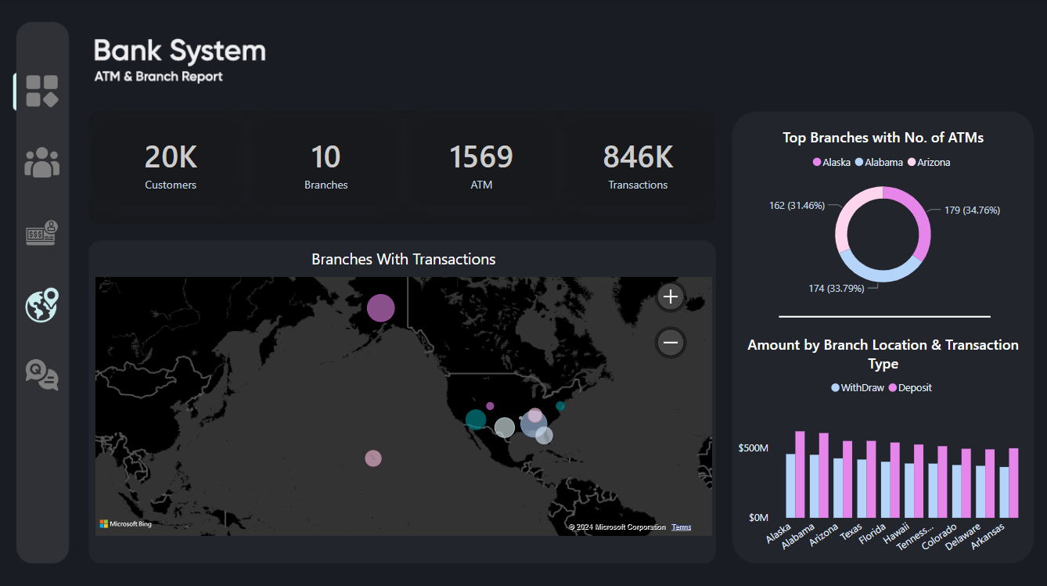
ATM & Branch Report

Slide 21
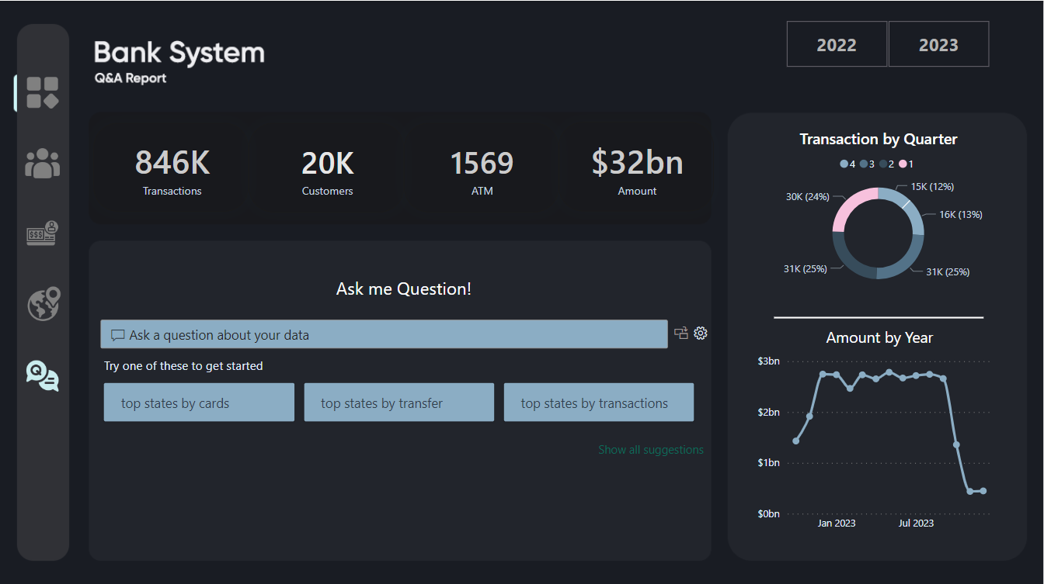
ATM & Branch Report

Slide 22
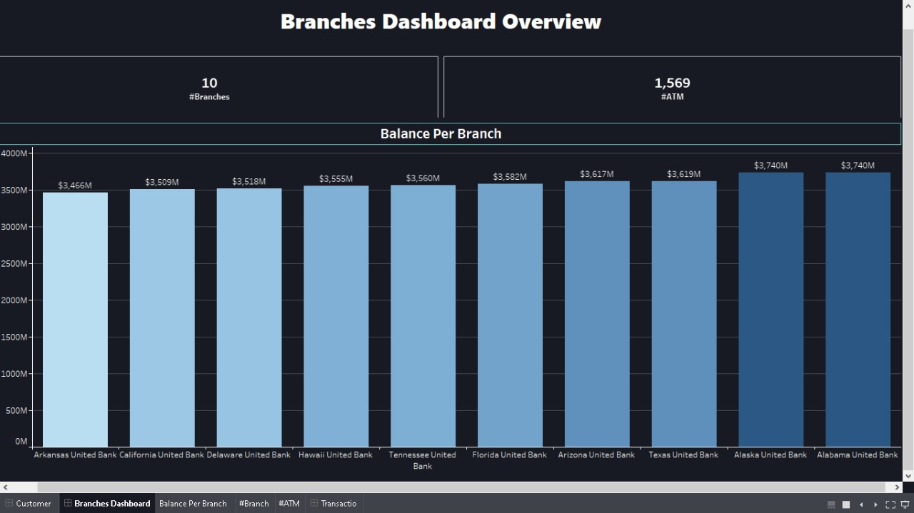
Visualize Tableau. Overview Report

Slide 23
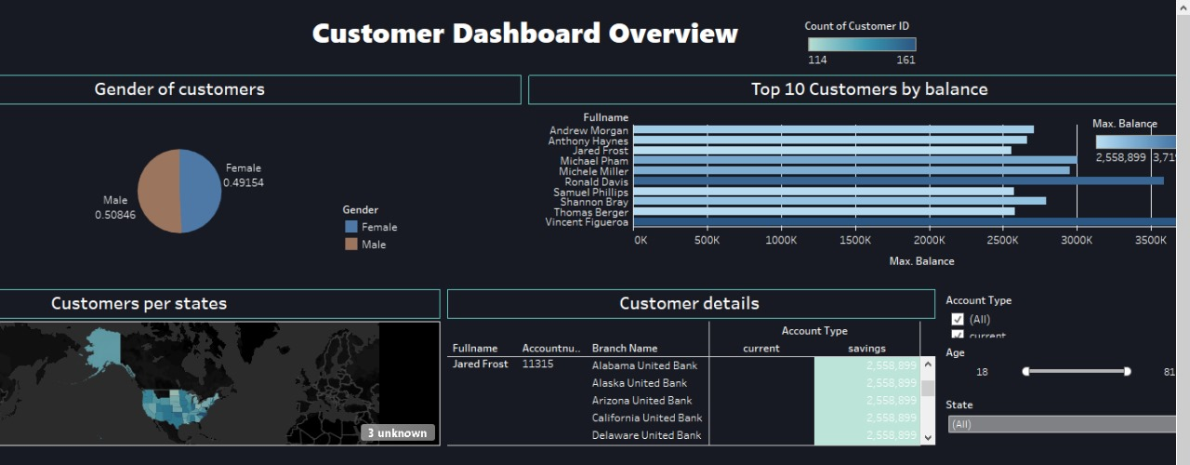
Visualize Tableau. Customer Report

Slide 24
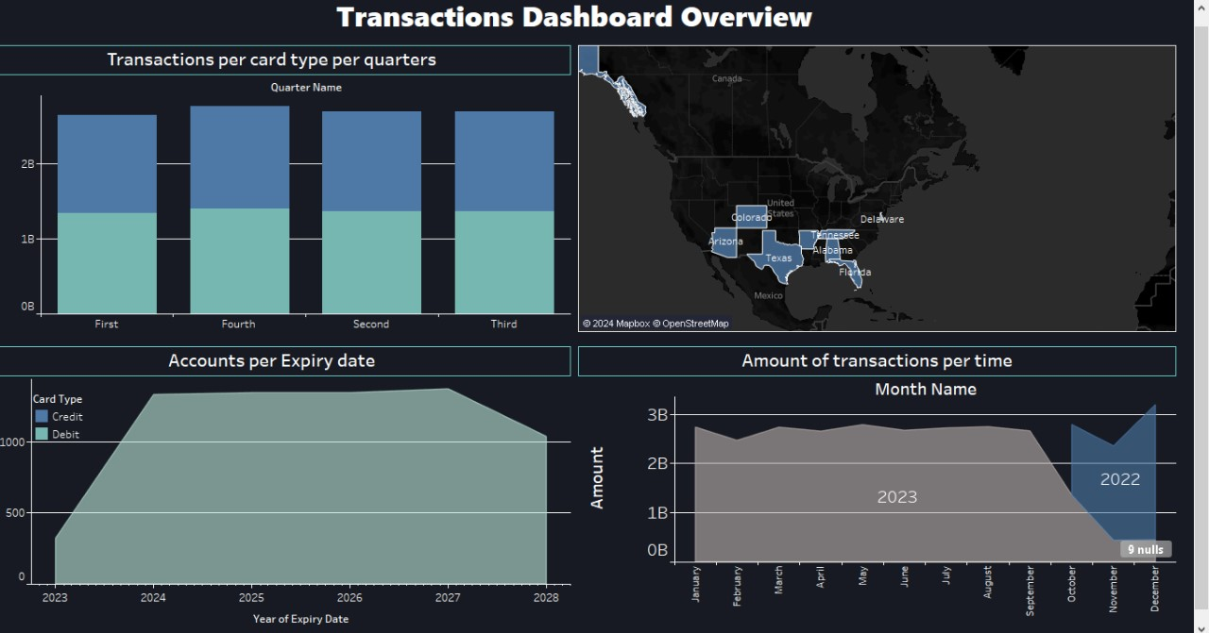
Visualize Tableau. Transaction Report

Slide 25


